Slide 1

Basic Details of the Team and Problem Statement
PSI : AI108
Problem Statement Title: Obscene content blocker
Problem Statement:
Team Name: Teamsolo
Team Leader Name: Kishan
Institute Name: MAIT
Theme Name: AIML

Slide 2
Idea/Approach Details
Design and develop a technological solution for identifying and blocking any obscene media (image/video/audio) at the user’s end. The solution should be able to send alerts to the concerned nodal agency in case of the spread of such content. The solution may be in the form of a desktop/mobile application or a web browser plugin.
HTML, CSS, JavaScript.
Flask.
Transformer models.
Beautiful soup.
NLTK.

Slide 3
Social impact and innovation
Innovation and USP
Social Impact
Reducing Exposure to Harmful Content
Promoting Digital Well-being
Empowering Users
Enhancing Online Safety Awareness
Facilitating Law Enforcement
2 Round verification, one static and one deep learning based.
Feedback system for fine-tuning the model.
Alerting nodal agencies/Notification system.
Customizability.
We also avoid the uninstall/Disable of the app.
Customization both on the level of engineering and business

Slide 4
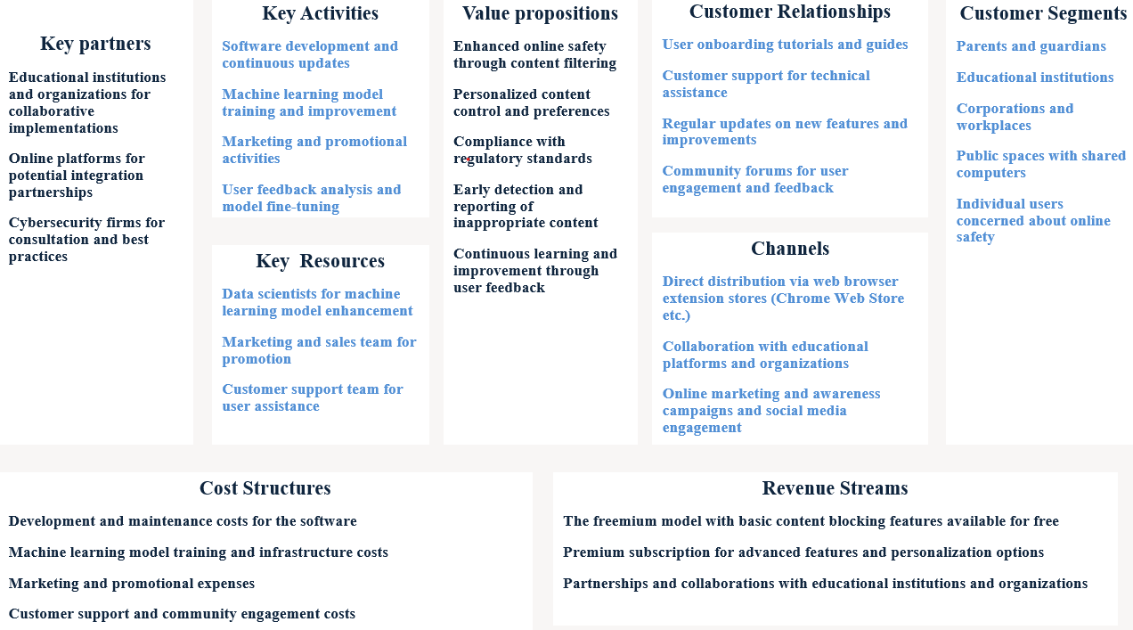
Business Model

Slide 5
Use Case :
Parental Control:
Parents want to ensure a safe online environment for their children.
Use Case: The browser extension helps parents filter and block explicit content, ensuring a child-friendly browsing experience.
Corporate Security:
Organizations aim to maintain a safe and secure working environment.
Use Case: The extension helps organizations block access to inappropriate content, fostering a professional and secure workplace.
Public Spaces:
Public places with shared computers (libraries, internet cafes) need to prevent access to explicit content.
Use Case: The extension helps maintain a safe browsing environment in public spaces, adhering to community standards.
Institutional Compliance:
Organizations need to comply with regulations regarding inappropriate content.
Use Case: The extension helps organizations meet compliance standards by actively blocking and reporting explicit content.
Individual User Control:
Users want to customize their online experience and avoid specific types of content.
Use Case: The extension allows users to define their content preferences, blocking or allowing websites based on their personal choices.

